Slide 1



Auto-generate a Data Vault Series
Part Two – Generating a Data Vault using an Offline Schema and Metadata Model
Peter Avenant and Michael Buller
peter.avenant@varigence.com.au
@BimlDownunder
michael.buller@stratuslive.com
@buller_michael
Copyright 2014 Varigence, Inc.

Slide 2
Auto-generate a Data Vault Series
Converting AdventureWorksLT2012
Generating a Data Vault using an Offline Schema and Metadata Model.
Populating the Data Vault Staging environment using BIML.
Populating the Historical Staging environment using BIML.
Populating Hubs using BIML.
Populating Satellites using BIML.
Populating Links using BIML.
Populating Reference Tables using BIML.
Translate Raw DV into Business DV using BIML
Generate a Star Schema from DW using BIML
Generate OLAP Cube from Star Schema using BIML
Generate Tabular Cube from Star Schema using BIML
Copyright 2014 Varigence, Inc.

Slide 3
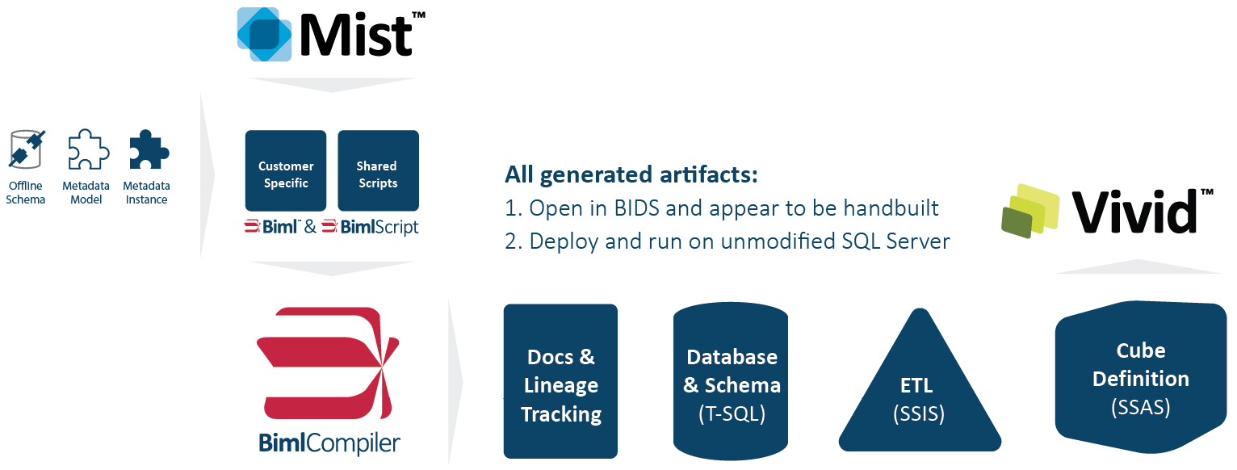
Product Overview
Copyright 2014 Varigence, Inc.
Notes:
This slide could probably be cut as you can cover this in talking points, but here it is, if you like

Slide 4
Part1 - Auto Generate
Step 1, Analyze
  Mark potential satellite tables
  Mark as peg leg Links
  Mark as links
  Mark as hubs
Step 3, Generate
  Create a hub and a satellite for each table marked as hub.
  Create links from relationships of tables marked as hubs
  Create links from tables marked as links
  Create satellites based on tables marked as satellites
Copyright 2014 Varigence, Inc.

Slide 5
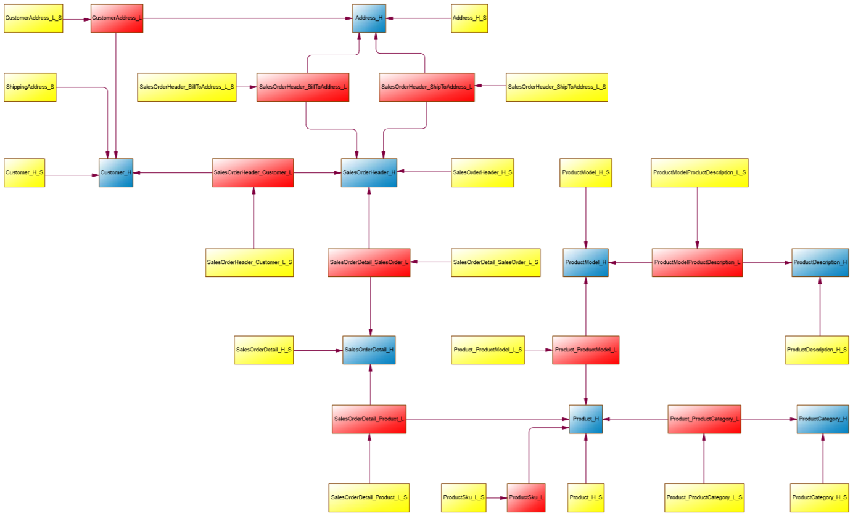
Our Results from Part 1
Copyright 2014 Varigence, Inc.

Slide 6


Step 1, Matadata Theory
STEP 2, Metadata 101 in mist
STEP 3, metadata model
STEp 4, metadata instance
STEP 5, offlineschema
&
What will we cover
Copyright 2014 Varigence, Inc.

Slide 7
Metadata Defined
Meta-modelling is the analysis, construction and development of the frames, rules, constraints, models and theories applicable and useful for the modelling in a predefined class of problems. - Wikipedia
There is a difference between business metadata and technical metadata.
Metadata describe the entity classes and attributes of an entity-relationship model, and the tables and columns by which these are implemented in a data warehouse.
Metadata are the data that describe the structure and workings of information, and which describe the systems it uses to manage that information.
Copyright 2014 Varigence, Inc.

Slide 8
Metadata Driven vs Hand Crafting
Phase A
Phase B
Phase C
Phase No End In Sight
Work Completed
BI Developer A
Metadata Developer
Project Finished
Time
Copyright 2014 Varigence, Inc.
Notes:
In phase A, the BI Developer who is hand crafting the implementation and the Metadata Developer are roughly equivalent in productivity. The BI Developer knows what they are doing and can quickly begin work. The Metadata Developer is also able to grasp the simple generation tasks and solve roughly the same amount of issues after a short amount of time. Then we enter the dangerous phase for Meta-programming. The developer has to stop, they might have to create a framework to manage the metadata due to complexity, they might have to spike and take time to solve a more complex problem. In the meantime the BI Developer is out there continuing forward and very likely bashing the metadata approach as a waste of time and not worth the effort. Then the Meta-programmer overcomes the delaying factor and finishes the project relatively shortly after in Phase C. However, the BI Developer who is hand crafting all of these objects is out there with no answers as to when they are going to finish and the business is anguishing in disgust at all of the needs that are going unmet.
<Remove below for brevity>
We want to help get you to the productive phase quicker. Biml is no exception to the rule however, many frameworks out there are great for getting you 80% of what you need in a short amount of time and then you run into that one thing that you can’t solve and you spend endless amounts of time trying to solve and in many cases have to abandon the implementation. You will need to grow into Biml but at least here we can show you that you can solve most problems as soon as you understand it.

Slide 9
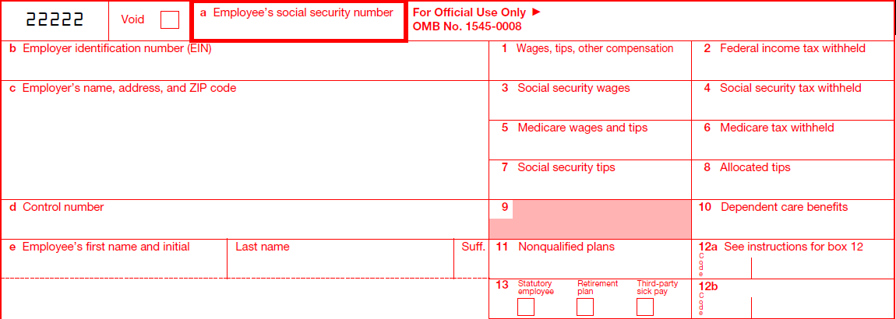
Metadata Model
Entity
Properties
Relationship
Copyright 2014 Varigence, Inc.
Notes:
The metadata model is the scaffolding for the types of data you are going to collect in use with your metadata programming. This is similar to a form that you have to fill out. The form has fields that have a name and it is expected that you would fill out the form with the correct type of data in each blank.

Slide 10
Metadata Instance
X
123-45-7890
12-4567890
$1,000.00
Entity
Properties
Relationship
Copyright 2014 Varigence, Inc.
Notes:
The Metadata Instance is represented by the actual values in the fields. The Model provides the names of the blanks, the shape of the fields i.e. data type, field length etc. You can then populate those with instances. These instances can be persisted in Mist using an In Memory version of the Instance. They can also be persisted to a more durable form such as an Excel spreadsheet or a Database. This get particularly useful when you can complete a framework for your metadata. Then most of the work you complete on a day to day basis is actually able to be automated as simple as filling out this form.

Slide 11
Metadata Model Tags Overview
<Biml xmlns="http://schemas.varigence.com/biml.xsd">
<Metadata>
<MetadataModel Name="MyMetadataModel">
<Entities>
<Entity Name="Connections">
<Properties>
<Property Name="ConnectionName" DataType="String" Length="100" Category="Connection" IsRequired="true" />
<Property Name="ConnectionString" DataType="String" Length="500" Category="Connection" IsRequired="true" />
</Properties>
</Entity>
<Entity Name="Tables">
<Relationships>
<Relationship Name="Connection" Cardinality="ManyToOne" EntityName="FrameworkModel.Connections" />
</Relationships>
<Properties>
<Property Name="TableName" DataType="AnsiString" Length="100" Category="Table" IsRequired="true" />
<Property Name="Schema" DataType="AnsiString" Length="50" Category="Table" IsRequired="true" />
</Properties>
<Validators>
<Validator />
</Validators>
</Entity>
</Entities>
</MetadataModel>
</Metadata>
</Biml>
-----------------------------------------------------------------------------------------------------------------→ Database
--------------------------------------------------------------------------------------------------------------------------------→ Table
--------------------------→ Column
--------------------------→ Foreign Key
------------------------------------------------------------------------------------------------------------→ Check Constraint, but much more
Copyright 2014 Varigence, Inc.
Notes:
This slide could probably be cut as you can cover this in talking points, but here it is, if you like

Slide 12
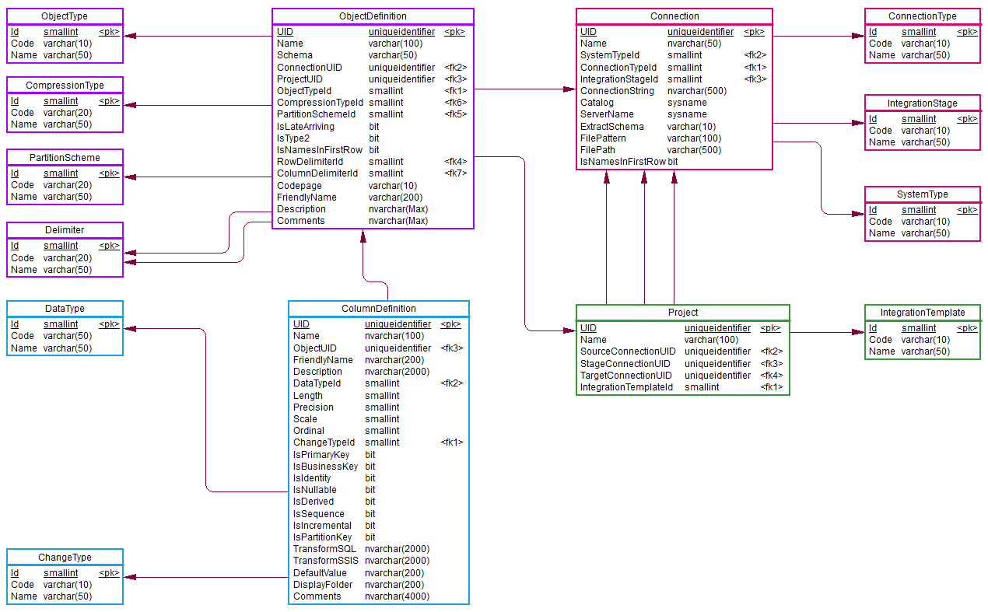
Sample Offline Metadata Model
Copyright 2014 Varigence, Inc.
Notes:
Discuss the basics covered in W02 - Moving ETL Loads to Azure Part1. Not to much detail here rather refer to the sessions that can be found on BimlScript.com

Slide 13
&
Demonstration
STEP 2, Metadata 101 in mist
Copyright 2014 Varigence, Inc.

Slide 14
&
Demonstration
STEP 3, metadata model
STEp 4, metadata instance
STEP 5, offlineschema
Copyright 2014 Varigence, Inc.

Slide 15
Biml Resources
Twitter
  @BimlScript
  @BimlDownunder
LinkedIn Biml User Group
  http://www.linkedin.com/groups?home=&gid=4640985&trk=anet_ug_hm
  https://www.linkedin.com/groups/BIML-User-Group-Denmark-8133770?gid=8133770
  http://www.linkedin.com/groups/Biml-User-Group-Australia-5190127?home=&gid=5190127
Varigence Mist
  http://www.varigence.com/mist
BimlScript
  http://www.bimlscript.com
CodePlex
  http://bidshelper.codeplex.com/
Biml Documentation
  http://www.varigence.com/documentation/biml/
Copyright 2014 Varigence, Inc.
Notes:
These are some additional resources for further updates and information

Slide 16
Data Vault Resources
Dan Linstedt
  http://www.danlinstedt.com
  http://www.learndatavault.com
  @dlinstedt
  Book - "Super Charge Your Data Warehouse"
Hans Hultgren
  http://www.geneseeacademy.com
  @gohansgo
  Book - "Modeling The Agile Data Warehouse with Data Vault"
http://www.dwhautomation.org/data-warehouse-generation-algorithm-explained
Copyright 2014 Varigence, Inc.
Notes:
These are some additional resources for further updates and information

Slide 17
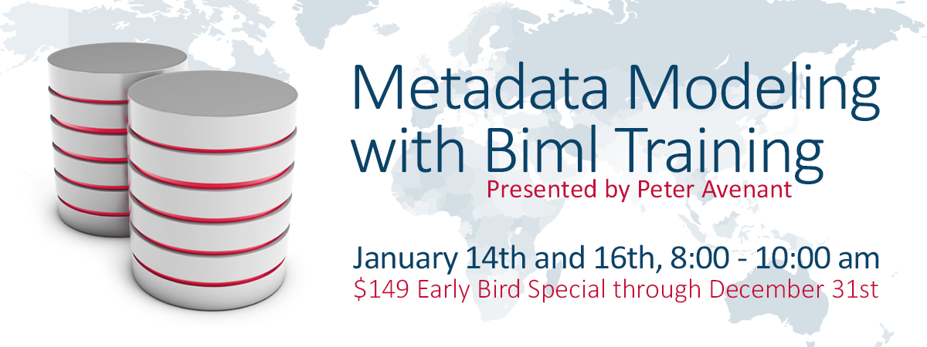
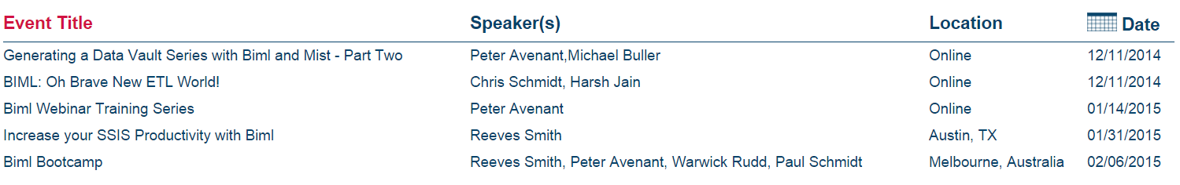
Upcoming Events
http://bimlscript.com/Event/Index/Upcoming
Copyright 2014 Varigence, Inc.

Slide 18
Thank You
www.bimlscript.com
Copyright 2014 Varigence, Inc.

