Slide 1



Auto-generate a Data Vault Series
Part One – Converting AdventureWorksLT2012
Peter Avenant and Michael Buller
peter.avenant@varigence.com.au
@BimlDownunder
michael.buller@stratuslive.com
@buller_michael
Copyright 2014 Varigence, Inc.

Slide 2
Auto-generate a Data Vault Series
Converting AdventureWorksLT2012
Generating a Data Vault using an Offline Schema and Metadata Model.
Populating the Data Vault Staging environment using BIML.
Populating the Historical Staging environment using BIML.
Populating Hubs using BIML.
Populating Satellites using BIML.
Populating Links using BIML.
Populating Reference Tables using BIML.
Translate Raw DV into Business DV using BIML
Generate a Star Schema from DW using BIML
Generate OLAP Cube from Star Schema using BIML
Generate Tabular Cube from Star Schema using BIML
Copyright 2014 Varigence, Inc.

Slide 3
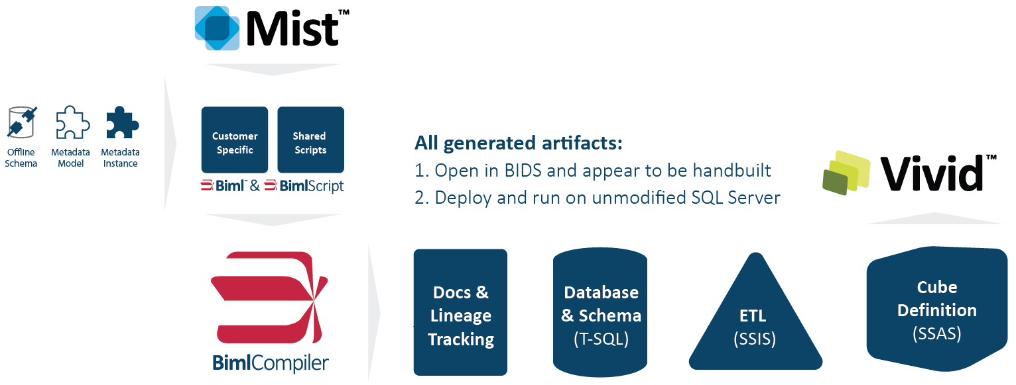
Product Overview
Copyright 2014 Varigence, Inc.
Notes:
This slide could probably be cut as you can cover this in talking points, but here it is, if you like

Slide 4
High Level Overview Without Data Vault
Operational
Stage
Kimball Data Warehouse
Cubes, OLAP, Tabular
Stage
BDW
ERP
Accounting
Extract
Transform Load
Extract
Sales
CRM
Documentation
Copyright 2014 Varigence, Inc.

Slide 5
Why do we need Data Vault?
When data vault modeling is applied, the resulting data warehouse will…
More readily absorb changes (improved agility)
Respond well to new subject areas (incremental build)
Innately manage historical time slices of data (historization)
Provide full traceability back to source feeds (auditability)
Grow and adapt with minimal impact, no silos (lower TCO)
Integrate, align & reconcile data (enterprise integration)
Track, manage and report on exceptions (provides feedback loop)
Hultgren, Hans (2014-03-22). Modeling the Agile Data Warehouse with Data Vault (Kindle Locations 450-461). New Hamilton. Kindle Edition. 1.
Copyright 2014 Varigence, Inc.

Slide 6
Layer Analysis
Operational | Data Warehouse | Data Mart
Data Capture | Data Integration | Data Delivery
Departmental | Enterprise Wide | Demand Driven
Transactional Processing | Integration Historization | Online Analytical Processing
Business Function | Core Business Concept | Fact Based Analysis
Accuracy | Completeness | Flexibility
Speed | Auditability | Usability
System of Record | All Data All Time | Right Data Right Time
Business Operations | Enterprise Knowledge | Specific Analytics
Capture and Log | Historize and Time Slice | Prepare and Deliver
Running of Operations | All Data Over Time | Presentation and Analysis
Firm | Agility | Respond and Deliver
Hultgren, Hans (2014-03-22). Modeling the Agile Data Warehouse with Data Vault (Kindle Location 699). New Hamilton. Kindle Edition.
Copyright 2014 Varigence, Inc.

Slide 7
Data Vault – The Hub
The Hub represents a Core Business Concept such as Customer, Vendor, Sale or Product. The Hub table is formed around the Business Key of this concept and is established the first time a new instance of that business key is introduced to the EDW.
A Hub may require a multiple part key to assure an enterprise wide unique key however the cardinality of the Hub must be 1: 1 with a single instance of the business concept.
The Hub contains no descriptive information and contains no FKs. The Hub consists of the business key only, with a data warehouse sequence id, a load date/ time stamp and a record source.
Hultgren, Hans (2014-03-22). Modeling the Agile Data Warehouse with Data Vault (Kindle Locations 1003-1008). New Hamilton. Kindle Edition.
Copyright 2014 Varigence, Inc.

Slide 8
Data Vault – The Link
The Link construct is used to represent all relationships in a data vault model. Each Link is based on a unique, specific, natural business relationship. In this way the Link is very much like a Hub. It captures only the existence of a relationship the same way that a Hub captures the existence of a business key.
The Link contains no descriptive information and does not have its own Business Key. The Link consists of the sequence ids of the concepts it is relating, with a warehouse machine Link sequence id, a load date/ time stamp and a record source. The Link captures the first time this relationship was seen in the data warehouse. So any subsequent references to the same keyed relationship will be ignored by the Link.
Hultgren, Hans (2014-03-22). Modeling the Agile Data Warehouse with Data Vault (Kindle Locations 1107-1109). New Hamilton. Kindle Edition.
Copyright 2014 Varigence, Inc.

Slide 9
Data Vault – The Satellite
The Satellite construct is perhaps the hardest working construct in data vault modeling. The Satellite tracks all context and all time-slice history in the data warehouse. The Satellite contains all descriptive information for both core business concepts and their relationships.
The Satellite does not have its own Business Key but manages all information and history concerning a Hub or Link by inheriting the Sequence ID from that Hub or Link. The two-part primary key for each Satellite is the inherited Sequence ID plus the Date/ Time Stamp. In this way the Satellite can track History in the same manner as a Type-2 Dimension (a Dimension designed to track history in the dimensional modeling approach).
The Satellite is the only construct in data vault modeling that uses the Date/ Time Stamp as part of the key. For this reason it is the only construct in data vault modeling capable of tracking history. The Satellite consists of the Sequence ID of the Hub or Link that it is describing, combined with a load date /time stamp to form a primary key, a record source and then a set of Context Attributes that depend on the Sequence ID.
Hultgren, Hans (2014-03-22). Modeling the Agile Data Warehouse with Data Vault (Kindle Locations 1337-1344). New Hamilton. Kindle Edition.
Copyright 2014 Varigence, Inc.

Slide 10
High Level Overview Without Data Vault
High Level Overview With Data Vault
Operational
Stage
Stage
Data Warehouse
Kimball Data Warehouse
Data Mart
Cubes, OLAP, Tabular
Stage
Stage
EDW
BDW
BDW
ERP
Data Mart
ERP
Accounting
Data Mart
Accounting
Load
Transform
Load
Transform
Load
Extract
Transform Load
Extract
Extract
Sales
Sales
Data Mart
CRM
CRM
Data Mart
Documentation
Copyright 2014 Varigence, Inc.

Slide 11
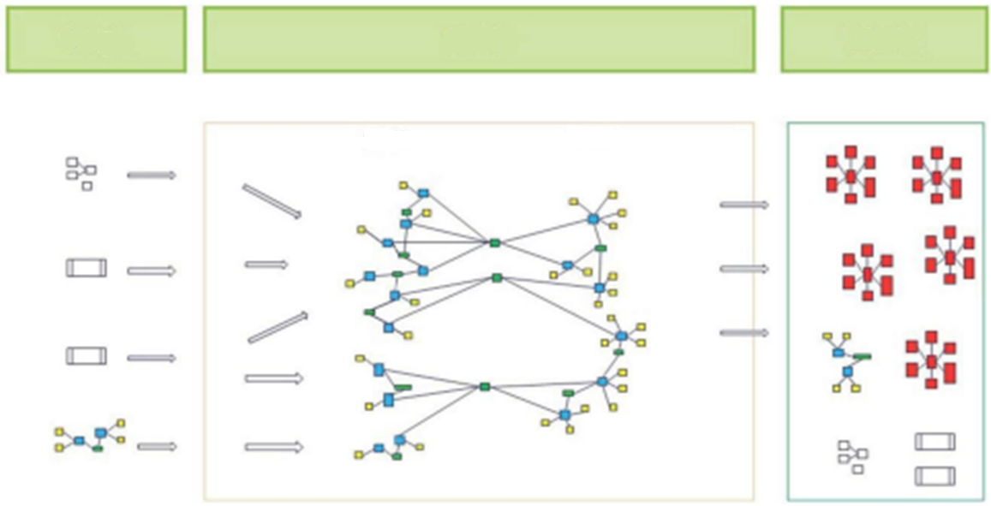
High Level Overview
Stage
Enterprise Data Warehouse
Data Marts
Raw
BDW
Hultgren, Hans (2014-03-22). Modeling the Agile Data Warehouse with Data Vault (Kindle Locations 2345-2346). New Hamilton. Kindle Edition.
Copyright 2014 Varigence, Inc.

Slide 12


Step 1, Analyze
STEP 2, Review
STEP 3, generate Model
STEp 4, QUICK PREVIEW of PACKAGE GENERATION
&
What will we cover
Copyright 2014 Varigence, Inc.

Slide 13
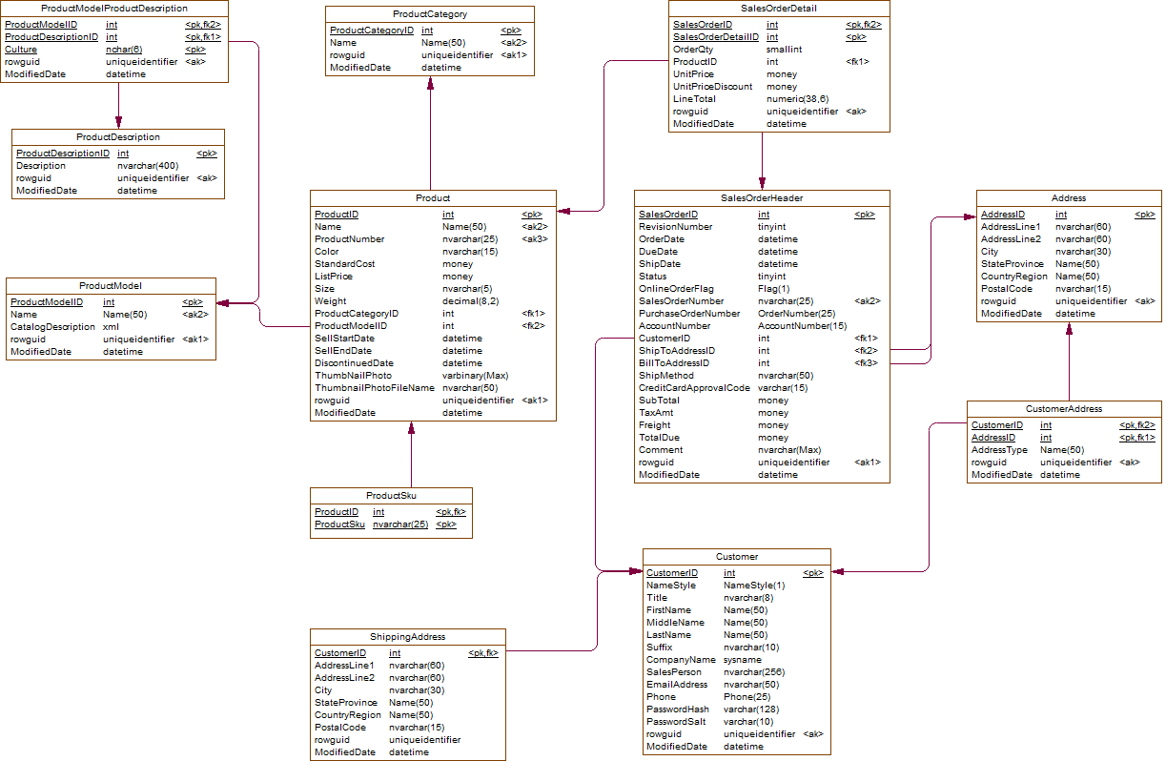
AdventureWorksLT Source
Copyright 2014 Varigence, Inc.

Slide 14
Step 1, Analyze
Mark potential satellite tables
  Every table on which there are no foreign keys referencing to and has only one foreign key with all the referencing columns also primary key columns and no other columns are part of primary key: is a candidate to become a satellite.
Mark as peg leg Links
  Every table on which there are no foreign keys referencing to and has only one foreign key with all the referencing columns also primary key columns but primary key is wider than the foreign key: is a candidate to become a peg leg link.
Mark as links
  Every table on which there are no foreign keys referencing to and has more than one foreign key with all the referencing columns also primary key columns: is a candidate to become a link.
Mark as hubs
  Every table which does not fit on any of the categories above is going to be a hub.
Copyright 2014 Varigence, Inc.

Slide 15
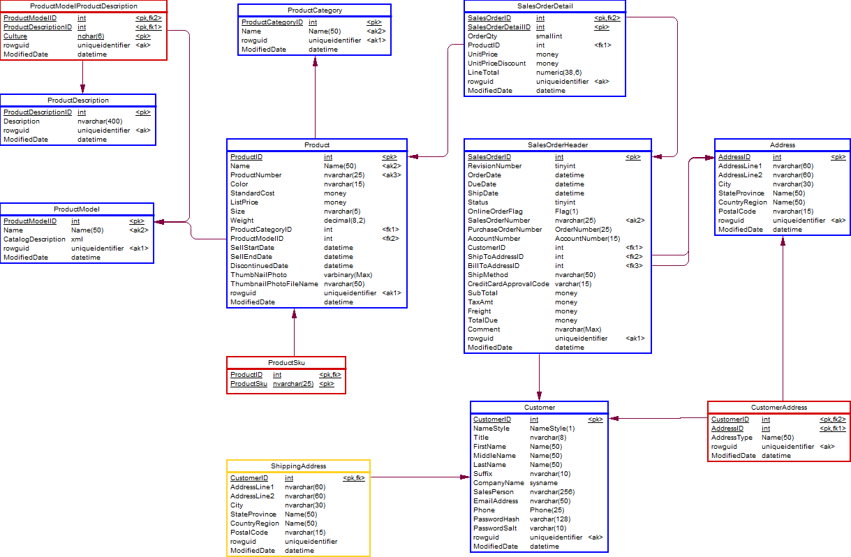
AdventureWorksLT Post Analyze
Copyright 2014 Varigence, Inc.

Slide 16
Step 1, Analyze
&
Demonstration
Copyright 2014 Varigence, Inc.

Slide 17
Step 2, Review
The analyst might not be happy with all the decisions of the analyzer and can overrule that output but not every change is possible.
Below is a list of possible changes.
Satellite -> Hub Every table marked as Satellite can very well be a Hub
Peg leg Link -> Multi-active satellite Every table marked as Peg leg link can be a Multi-active satellite
Peg leg Link -> Hub Every table marked as Peg leg link can be a Hub
Link -> Hub Every table marked as Link can also be a Hub
In our sample model we are not going to apply and change on the result of the analyzer.
Copyright 2014 Varigence, Inc.

Slide 18
Step 3, Generate
Create a hub and a satellite for each table marked as hub.
Create links from relationships of tables marked as hubs
Create links from tables marked as links
Create satellites based on tables marked as satellites
Copyright 2014 Varigence, Inc.

Slide 19
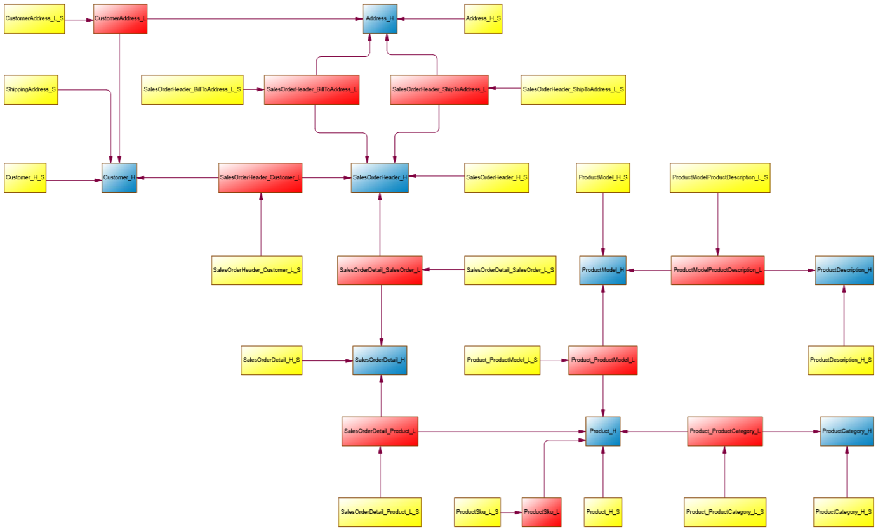
Our Results
Copyright 2014 Varigence, Inc.

Slide 20
Step 3, Generate MODEL
&
Demonstration
Copyright 2014 Varigence, Inc.

Slide 21
STEp 4, QUICK PREVIEW of PACKAGE GENERATION
&
Demonstration
Copyright 2014 Varigence, Inc.

Slide 22
Biml Resources
Twitter
  @BimlScript
  @BimlDownunder
LinkedIn Biml User Group
  http://www.linkedin.com/groups?home=&gid=4640985&trk=anet_ug_hm
  https://www.linkedin.com/groups/BIML-User-Group-Denmark-8133770?gid=8133770
  http://www.linkedin.com/groups/Biml-User-Group-Australia-5190127?home=&gid=5190127
Varigence Mist
  http://www.varigence.com/mist
BimlScript
  http://www.bimlscript.com
CodePlex
  http://bidshelper.codeplex.com/
Biml Documentation
  http://www.varigence.com/documentation/biml/
Copyright 2014 Varigence, Inc.
Notes:
These are some additional resources for further updates and information

Slide 23
Data Vault Resources
Dan Linstedt
  http://www.danlinstedt.com
  http://www.learndatavault.com
  @dlinstedt
  Book - "Super Charge Your Data Warehouse"
Hans Hultgren
  http://www.geneseeacademy.com
  @gohansgo
  Book - "Modeling The Agile Data Warehouse with Data Vault"
http://www.dwhautomation.org/data-warehouse-generation-algorithm-explained
Copyright 2014 Varigence, Inc.
Notes:
These are some additional resources for further updates and information

Slide 24
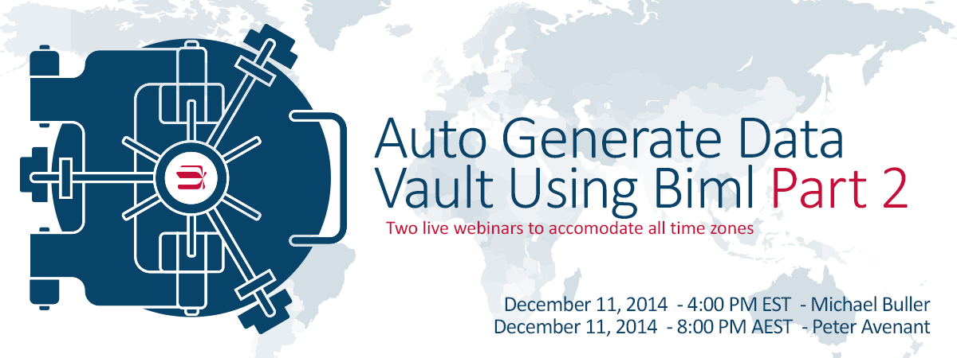
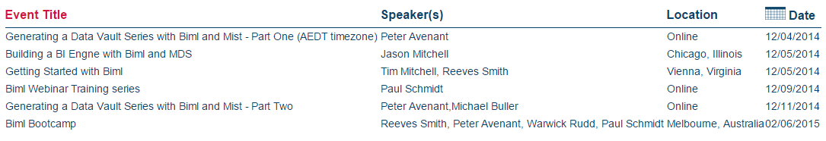
Upcoming Events
http://bimlscript.com/Event/Index/Upcoming
Copyright 2014 Varigence, Inc.

Slide 25
Thank You
www.bimlscript.com
Copyright 2014 Varigence, Inc.

