Slide 1
Biml - Introduction Session
Peter Avenant
peter.avenant@varigence.com.au

Slide 2
A little bit about me
Been using BimlScript for 4 years
Used BidsHelper for over 2 years
Absolutely Biml mad and proud of it
BimlScript.com contributor
Co-founder of Varigence Australia in 2014

Slide 3
What’s This All About?
Learn how to develop Microsoft BI Projects faster, more consistently, and more reliably than you ever thought possible…
… and have fun doing it.

Slide 4

Biml is like HTML for Microsoft SQL Server
XML based: Human Readable
Full fidelity with Microsoft SQL Server product family
  If you can do it in BIDS, you can do it in BIML

Slide 5

BimlScript is to Biml what ASP.NET is to HTML
  Metadata driven SQL Server development
BimlScript Types
  Expandable Biml Scripts
  *Live Biml Scripts
  *Transformer Biml Scripts
* Only supported in Mist / Biml

Slide 6
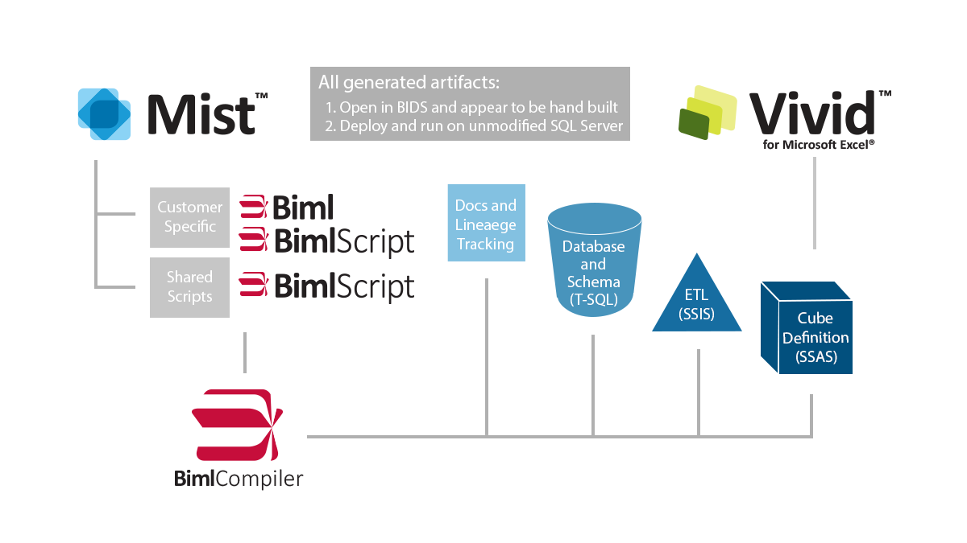
Product Overview
Notes:
This slide could probably be cut as you can cover this in talking points, but here it is, if you like

Slide 7
What will we cover today?
Create environment script
Import Table Schema for Source
Change script to use include file
Change script to use CallBimlScript

Slide 8

Resources
Twitter
  @BimlScript
  @BimlDownunder
LinkedIn Biml User Group
  http://www.linkedin.com/groups?home=&gid=4640985&trk=anet_ug_hm
  http://www.linkedin.com/groups/Biml-User-Group-Australia-5190127?home=&gid=5190127
Varigence Mist
  http://www.varigence.com/mist
BimlScript
  http://www.bimlscript.com
CodePlex
  http://bidshelper.codeplex.com/
Biml Documentation
  http://www.varigence.com/documentation/biml/
Notes:
These are some additional resources for further updates and information

