Slide 1
Biml - Transformers Webinar
Peter Avenant
peter.avenant@varigence.com.au

Slide 2
A little bit about me
Been using BimlScript for about 4 years
Used BidsHelper for just over 2 years
Absolutely Biml mad and proud of it
BimlScript.com contributor
Co-founder of Varigence Australia in 2014

Slide 3
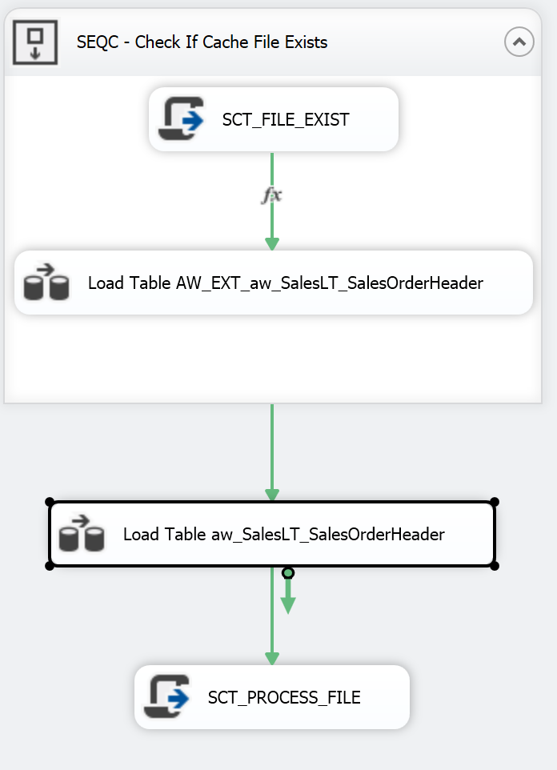
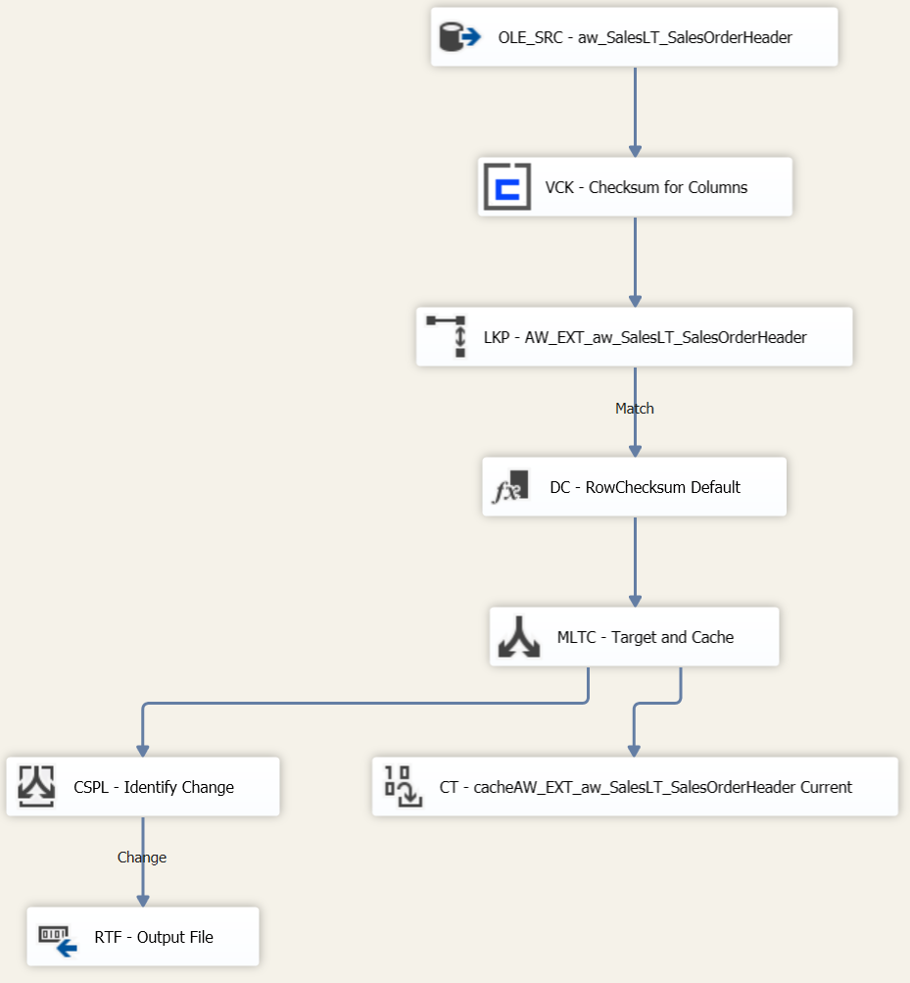
What we covered so far
Notes:
Discuss the basics covered in W02 - Moving ETL Loads to Azure Part1. Not to much detail here rather refer to the sessions that can be found on BimlScript.com

Slide 4
Why use Biml?
Enforcement of standard patterns, best practices
Speed and performance of development
  economy of scale and reusability
Manage changes mid-project or in production
Reduce tedious and repetitive work
  spend time where it matters most
More configuration, less development
  Metadata, metadata, metadata
Notes:
Simply put here I discuss the need for the highlighted text in DWH life cycle. Highlight the need for a reusable configurable framework.

Slide 5
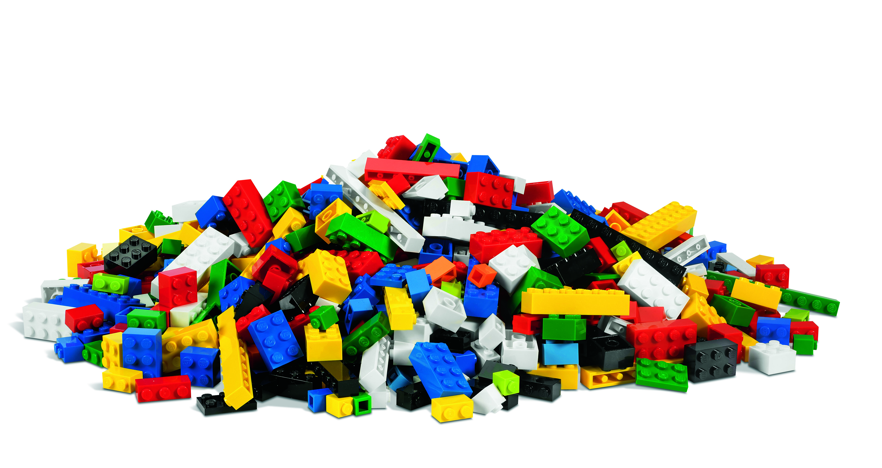
Just Like Building Lego
Notes:
Toy building bricks are the ultimate reusable component and Biml gives you that flexibility to Automate Development of SQL Server, SSIS, and SSAS
Biml allows you to create patterns and components to turn tedious, repetitive work into reusable scripts, much like the toy bricks can be reused to build different solutions. Notice that even in a manual solution (the brick pile) there is consistency in size, shape, and color, but it’s difficult to find any particular brick, understand the organization, or add features without significant effort.

Slide 6
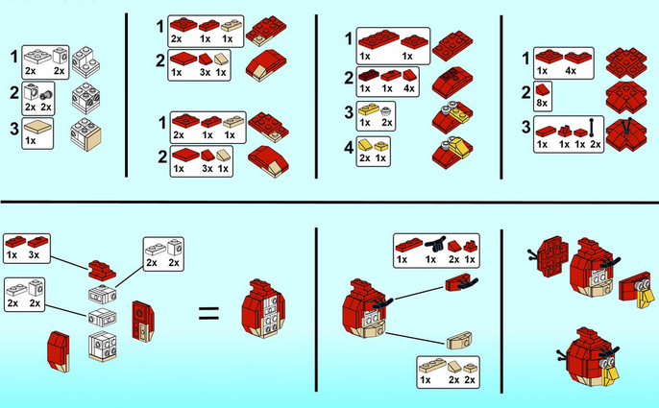
Define Patterns & Frameworks
Notes:
But what if we had an instruction manual or a rubric for createing structures according to well defined patterns?
Now that can create the reusable components the BI architects can build the implementation plan that will bring it all together.
Using Biml you can create reusable components for common BI tasks and turn complex ETL patterns into simple, layered steps.
You could even drive the entire code generation process from metadata that can live anywhere.

Slide 7
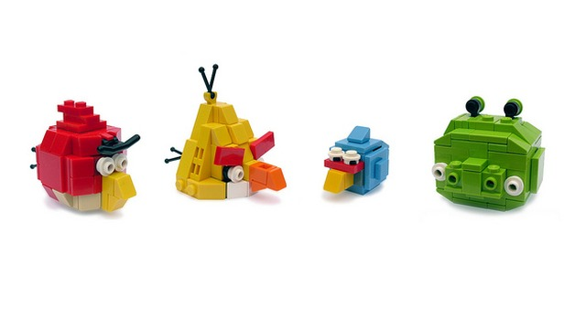
Unique, Repeatable Solutions
Notes:
Redefine Business Intelligence ROI
With advanced design patterns and abstractions, and powerful scripting and reuse capabilities, we can deliver BI solutions that are on-time and on-budget.
Transformer BimlScripts allow you to automatically enforce design patterns and frameworks at compile time. Developers interact to create custom logic, change patterns, or guide the specification of configuration. They no longer need to rebuild and maintain the expensive, manual plumbing.

Slide 8
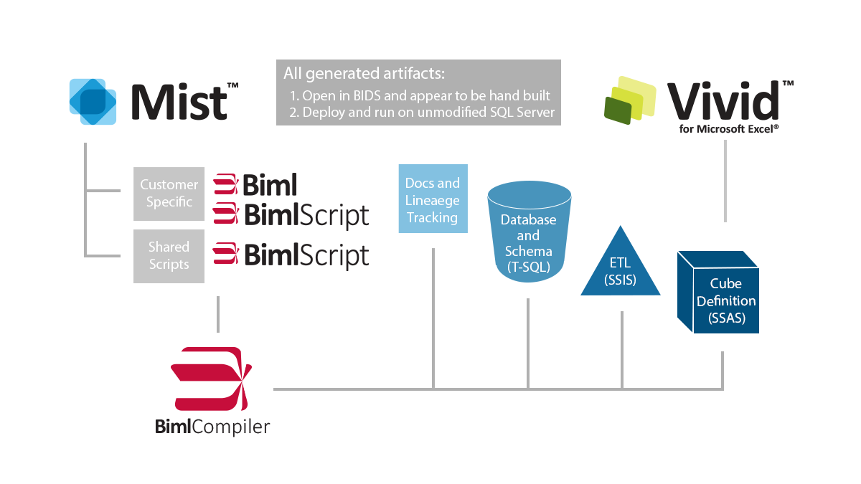
Product Overview
Notes:
This slide could probably be cut as you can cover this in talking points, but here it is, if you like

Slide 9
frameworks
Plumbing should be hidden

Slide 10
What will we covered today
Notes:
Ask the audience when looking at the images what they deem to be BUSINESS LOGIC and what they would class as DATA WAREHOUSE internal operations. Discuss a bit about how we as DWH professionals are so close to the process that we believe that the “plumbing” is actually required and that the business users should understand it. STOP IT they do not care about dimensions, facts, attributes, type1 or 2, they just want their reports and data to analyze. I will now show you what I perceive to be “plumbing” and then show you how using Mist Transformers we hide the plumbing in the SSIS walls. First lets get rid of the Control Flow pluming… Pause for effect ☺ Now the Data Flow… Pause for effect again ☺ That’s right I believe that only the source and the target in this staging example is deemed to be business logic. If you are anything like me it took me a while to get my head around this. Once you understand the difference between which components is internal DWH operations and which is actual business logic you will know the components that should be in your solution and the components that should be in you Transformer Framework.

Slide 11
Transformer frameworks
Demonstration

Slide 12
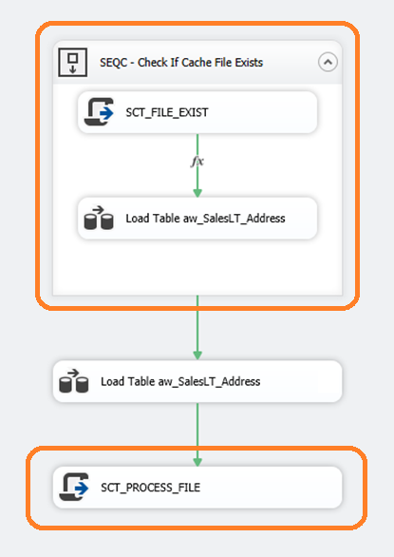
What we will Demo
tf-package-source-container.biml
tf-package-target-script.biml
Notes:
Discuss the basics covered in W02 - Moving ETL Loads to Azure Part1. Not to much detail here rather refer to the sessions that can be found on BimlScript.com

Slide 13
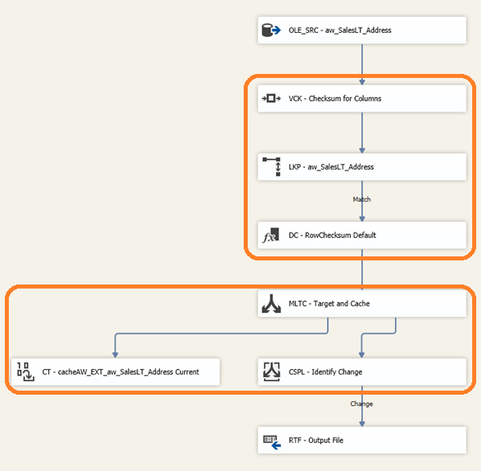
What we will Demo
tf-package-source-lkp.biml
tf-package-target-destination.biml
Notes:
Discuss the basics covered in W02 - Moving ETL Loads to Azure Part1. Not to much detail here rather refer to the sessions that can be found on BimlScript.com

Slide 14

Resources
Twitter
  @BimlScript
  @BimlDownunder
  @SQLReeves
LinkedIn Biml User Group
  http://www.linkedin.com/groups?home=&gid=4640985&trk=anet_ug_hm
  https://www.linkedin.com/groups/BIML-User-Group-Denmark-8133770?gid=8133770
  http://www.linkedin.com/groups/Biml-User-Group-Australia-5190127?home=&gid=5190127
Varigence Mist
  http://www.varigence.com/mist
BimlScript
  http://www.bimlscript.com
CodePlex
  http://bidshelper.codeplex.com/
Biml Documentation
  http://www.varigence.com/documentation/biml/
  http://www.sqlservercentral.com/stairway/100550/
Notes:
These are some additional resources for further updates and information

